Slide 1

MINIBOX
YOU. SEE. TOO.

Slide 2
What is inside the MiniBOX?
Sample Holder
Holds the sample inside a cube
Mirror
Reflects light
Sample Holder
Mirror
Mirror
Convex Lens
40 mm
Convex Lens
40 mm
Convex Lens
100 mm
Microscope Objective
A special lens system for magnifying the Sample
Lens
Influences the propagation of light
Concave Lens
-50 mm
4×
Objective
YOU.
SEE.
TOO.

Slide 3
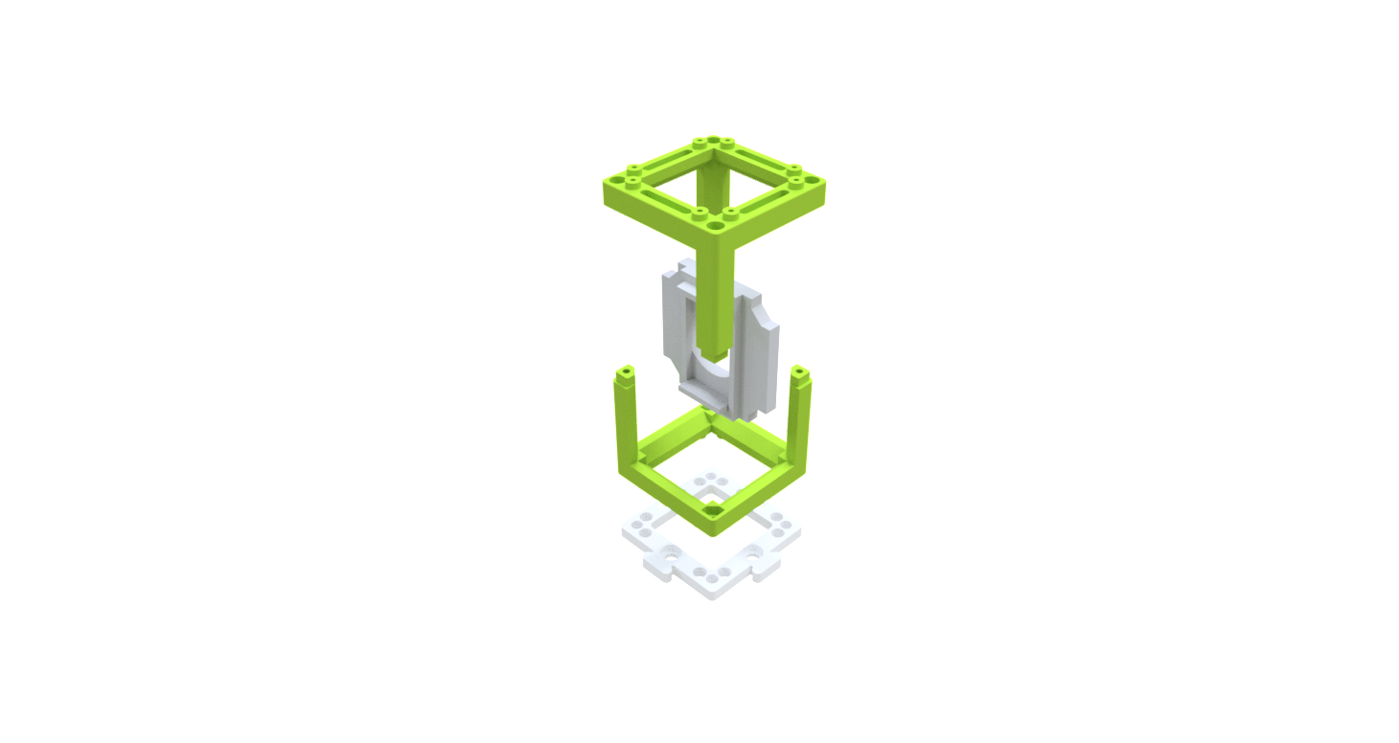

What is UC2?
The basic building block of the UC2 project is a simple cube.
The cube consists of two halves and holds an insert that can be moved within it.
The inserts can hold various optical components (lenses, mirrors, …) and by that they give the cube a function.
Type 1: Injection moulded cube with pins
Cube
Baseplate
The cubes attach to a baseplate. The baseplate works like a puzzle
Cube (half)
Insert (Sample holder)
Cube (half)
Baseplate
YOU.
SEE.
TOO.

Slide 4
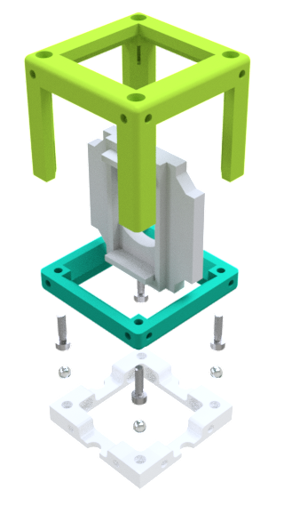
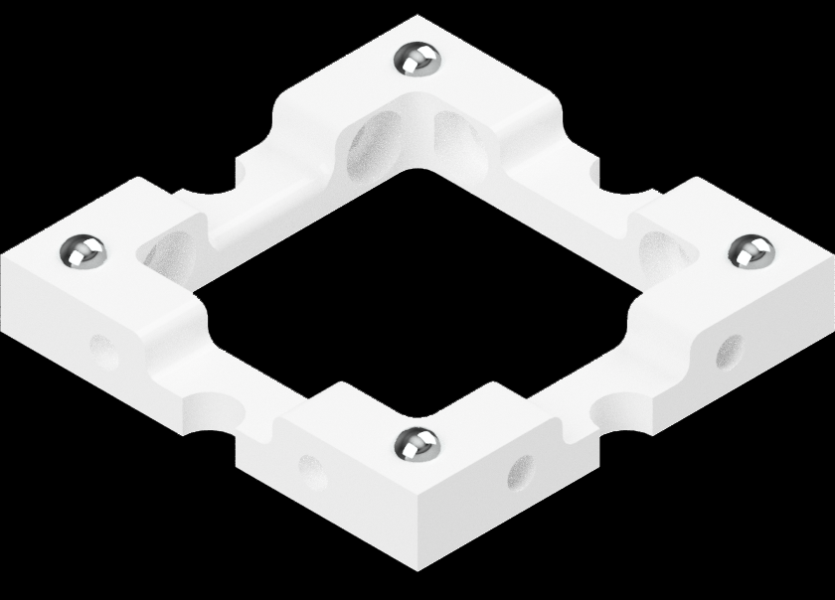
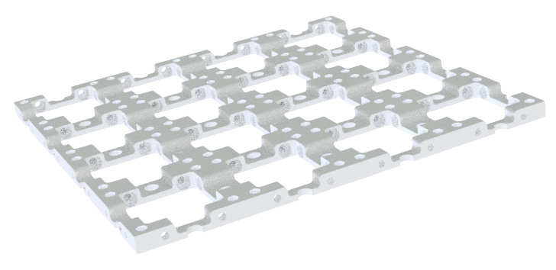

UC2 as DIY
The UC2 cube can also be 3D printed. It looks almost the same, but this time it has a cube-body and a cube-lid. These are assembled using screws. The screws then attach to the magnets in the baseplate. The various modules can create many different setups. Each new cube can add a new function. No limits to creativity!
Type 2: 3D-printed Cube with magnetic connection
Baseplate
Cube
There are four small ball magnets pressed into each baseplate unit.
Cube (Body)
Insert (Sample Holder)
Cube (Lid)
Screws (magnetic)
Do you want to have more cubes? You can build everything yourself. Find everything here
Ball magnets
Baseplate
YOU.
SEE.
TOO.

Slide 5
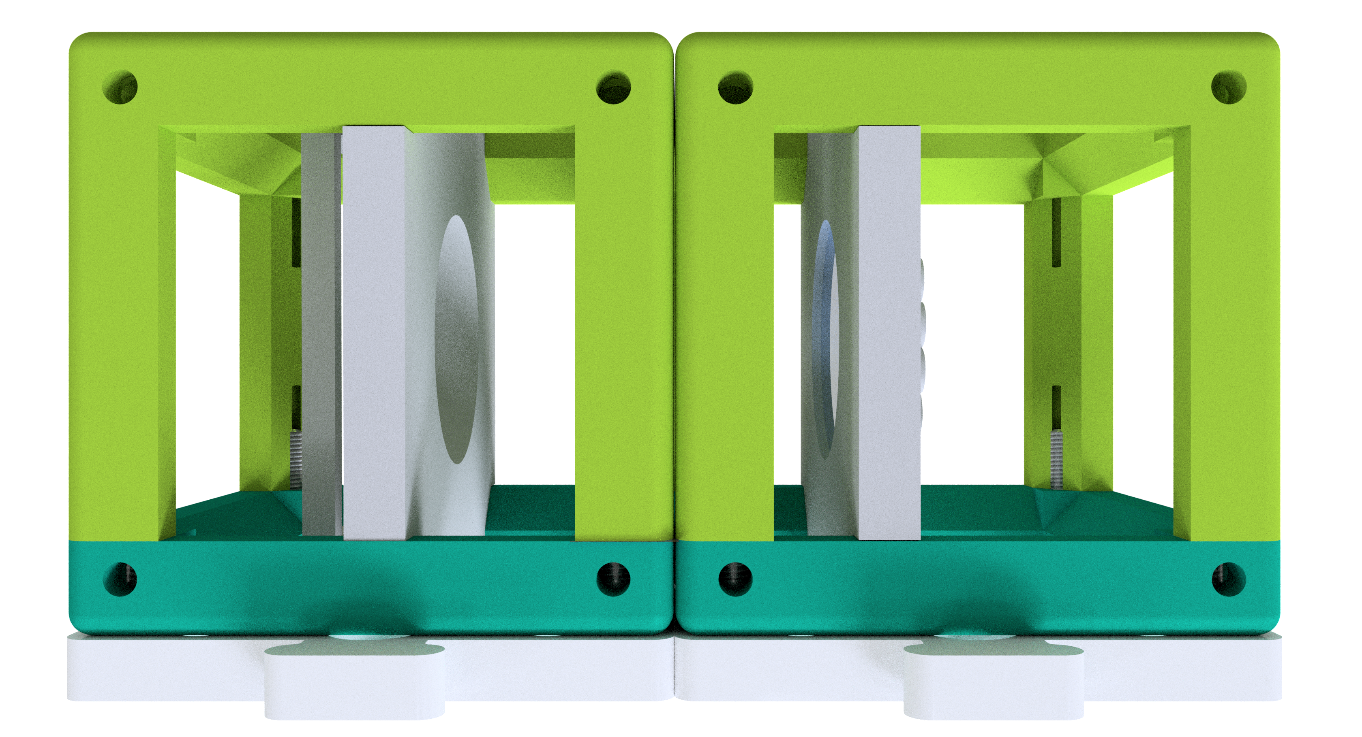
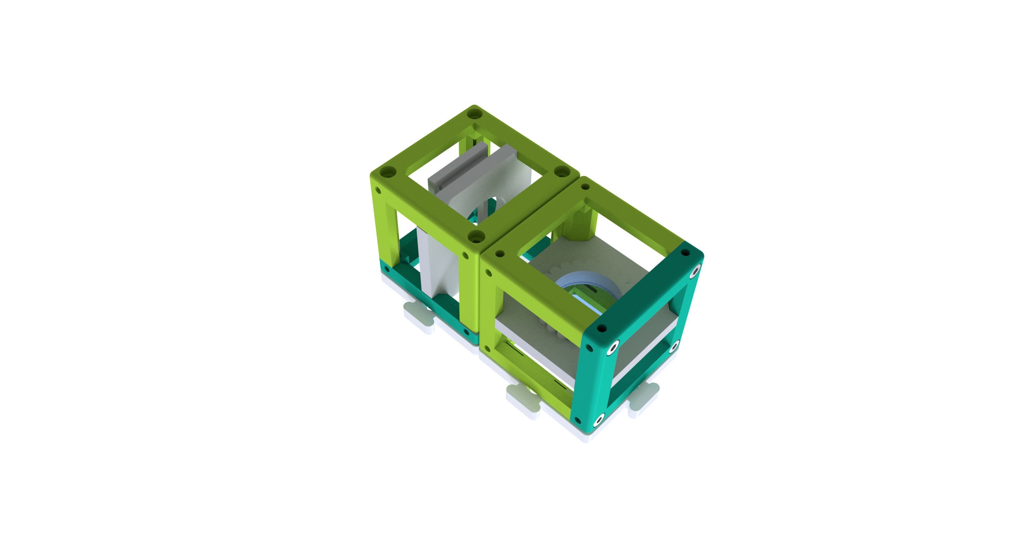

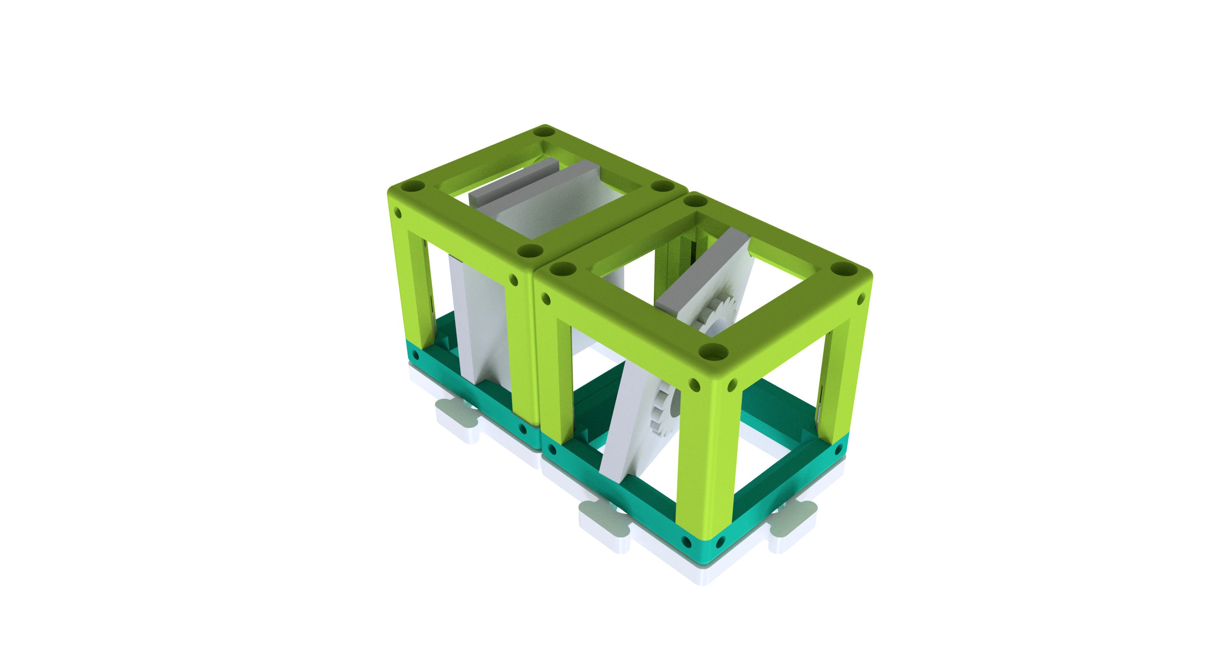
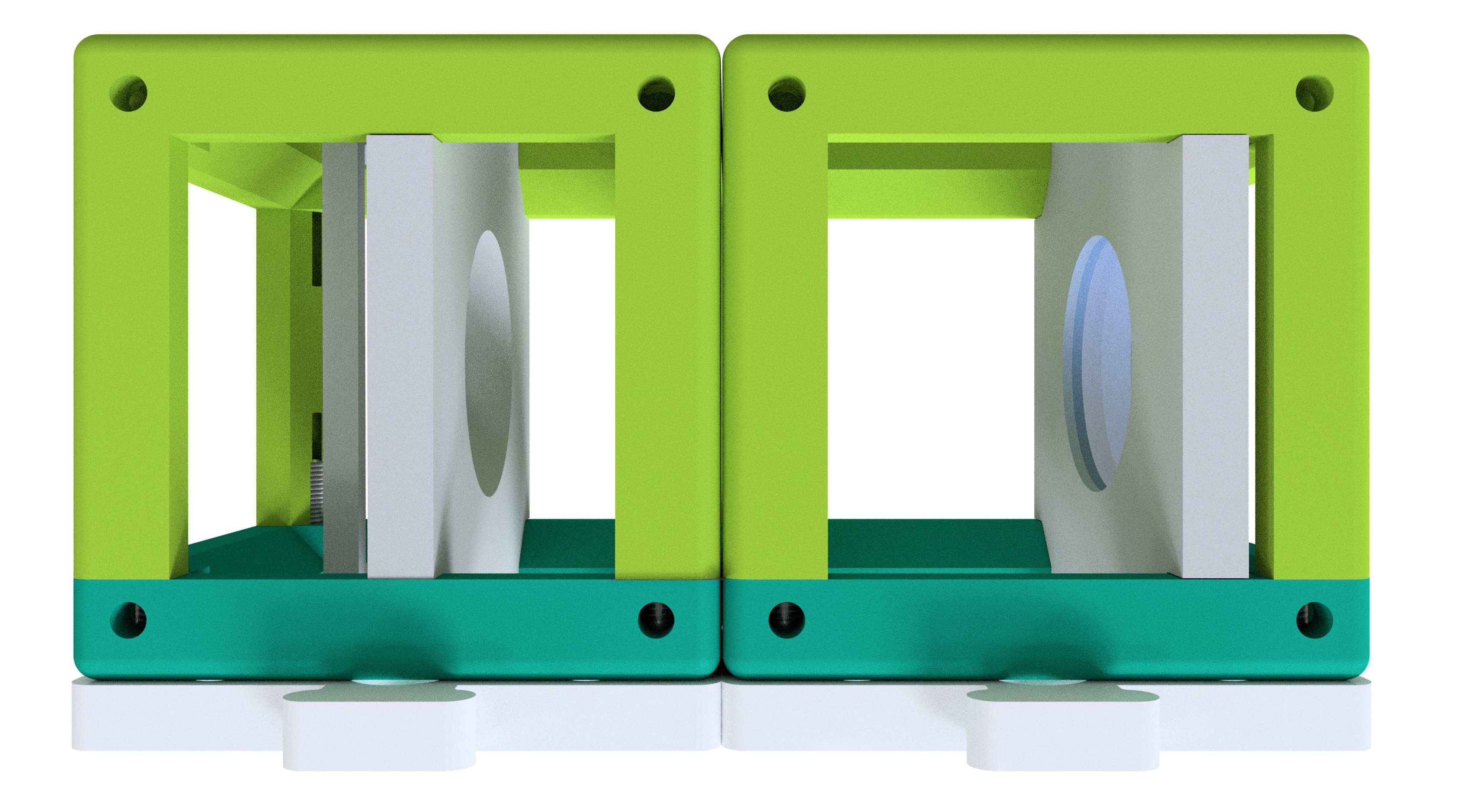
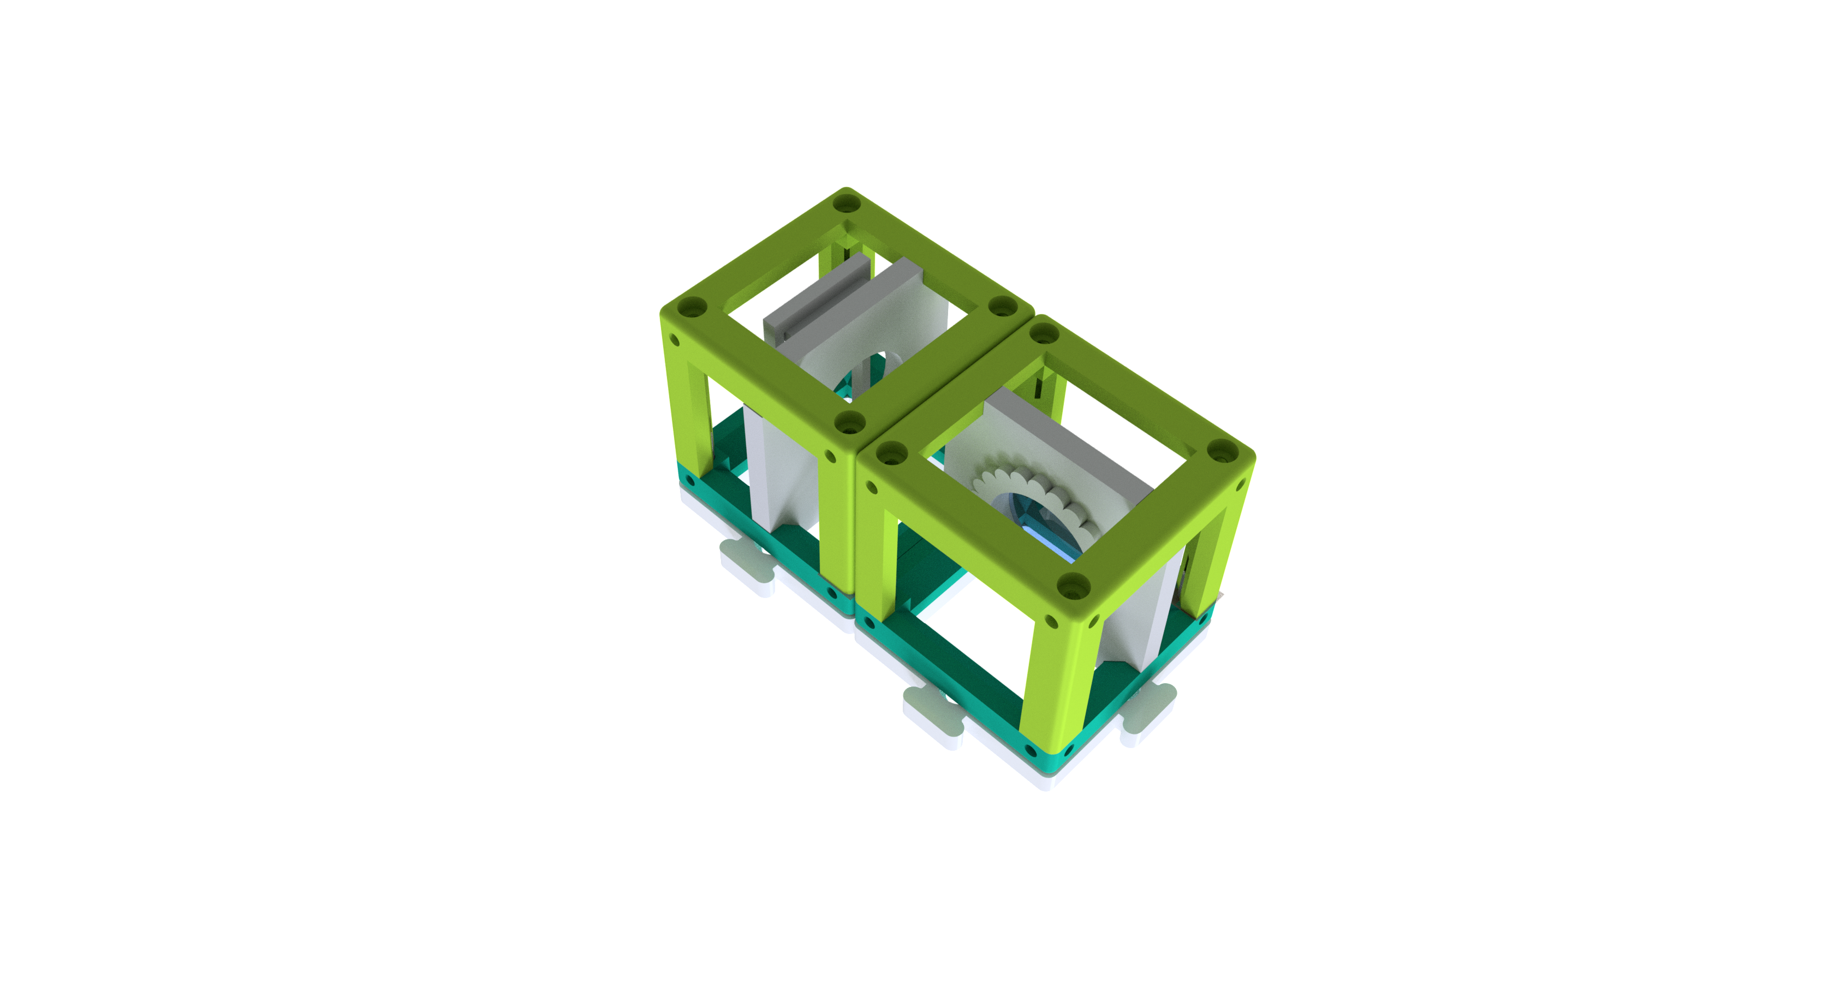
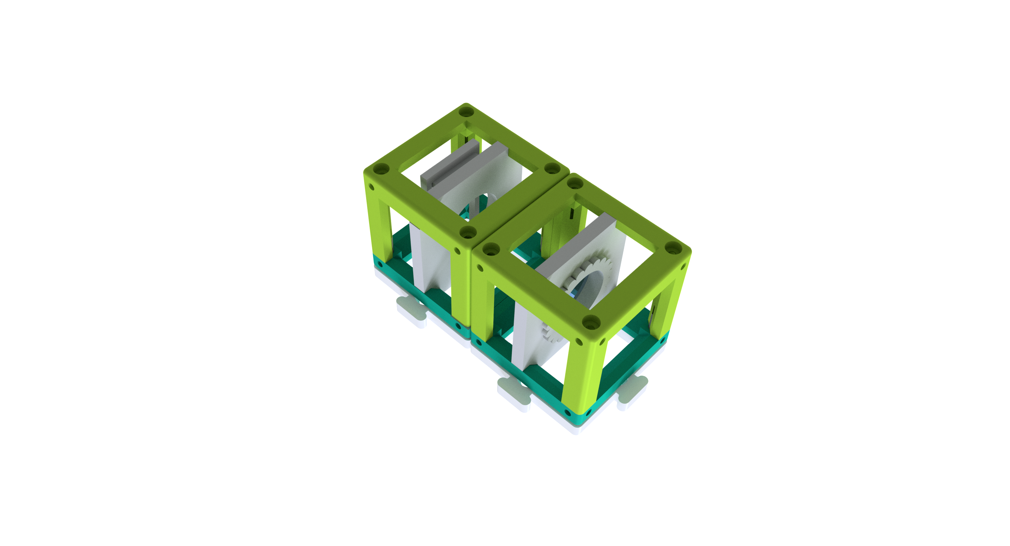

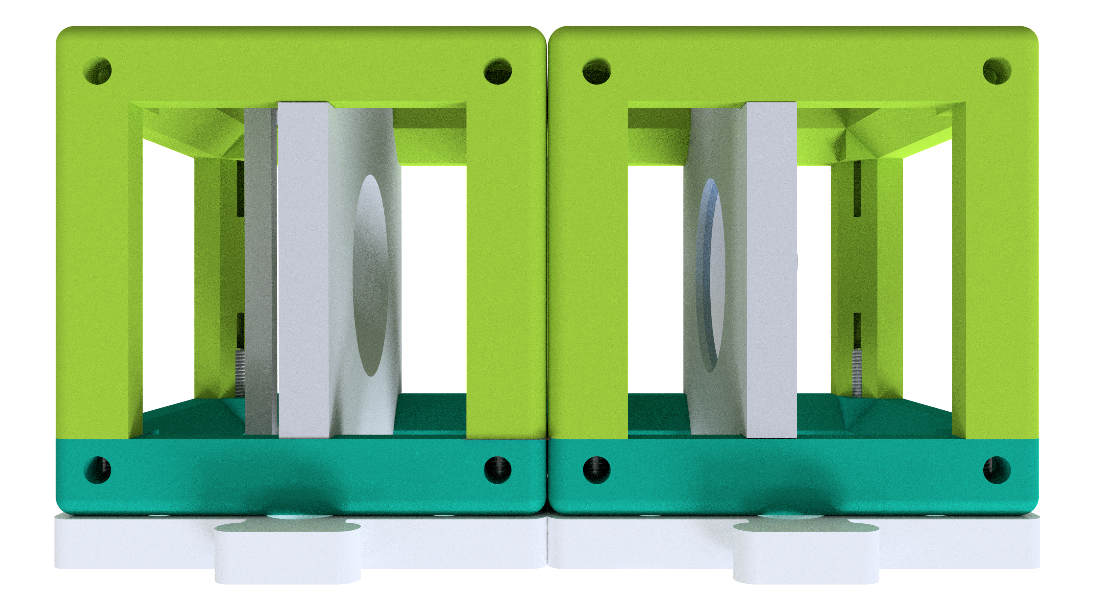
How do the cubes fit together?
Make sure the cubes sit precisely on the baseplate. It is important to align the inserts to their correct positions.
When you cannot see a sharp image, move the insert (for example the lens) inside the cube to focus the image, as the green arrow shows in the picture above.
YOU.
SEE.
TOO.

Slide 6







0
1
2
3
4
5
10
15
What do the symbols mean?
Experiment
When you see this block, there is an experiment to be done! You place the cubes on the blocks according to the schemes
On every page of the booklet is a ruler for measuring the distances between the inserts.
Explanation
When you see this symbol, there is something to be learned
Careful!
Don‘t touch the glass surfaces with your fingers!
Cleaning the lenses
If you did touch an optical surface, clean it using a cloth for cleaning of glasses.
Calculation
When there is something to calculate, take a pen and paper and find out the result.
Here are questions
Here are some hints
Here you find answers
YOU.
SEE.
TOO.

Slide 7

0
1
2
3
4
5
10
15
What can a lens do?
Take the cubes with lenses inside and look through them at the UC2 logo on this page. Hold the cube in your hand and change the distance between the cube and the page while looking through
How does the image look like?
Different lenses have different properties. What difference do you see between the lenses here?
YOU.
SEE.
TOO.

Slide 8
Lenses
Ray optics is a simplified model where light is represented by rays . A light ray has a direction of propagation and is drawn as and arrow. Lenses “ break“ the rays, which means tey change their directions.
Light ray
Convex lenses
Concave lenses
In a scheme
In a scheme
In reality
In reality
Converging lens
Zerstreuungslinse
„Focal point“ F‘
Focal point F‘
Parallel rays
Optical axis
Parallel rays
Optical axis
Focal plane
Focal plane
Focal length f‘ (positive)
Focal length f‘ (negative)
Convex lenses break the light rays, that are parallel to the optical axis, into a point in the focal plane called the focal point.
Concave lenses break the light rays, that are parallel to the optical axis, as if they were all coming from a point in the focal plane called the „virtual“ focal point.
YOU.
SEE.
TOO.

Slide 9
Bei der Sammellinse wird das Bild vergrößert und die Vergrößerung ist für das f = 40 mm-Objektiv und das f = 100 mm-Objektiv unterschiedlich. Das Bild kann aufrecht oder invertiert sein.
Lenses „break“ the light rays
The focal lengths are written on the lens inserts. The are two 40 mm convex lenses, one 100 mm convex lens and one -50 mm concave lens.
With the convex lens we can magnify the image and the magnification is different for the 40 mm lens and the 100 mm lens. The image can be upright or inverted.
The convex lenses are also called converging or positive. The centre of the lens is thicker than the edge. It can make the object bigger-looking.
The concave lenses are also called diverging or negative. The centre of this lens is thinner than the edge. The image always looks smaller through these lenses.
With the concave lens (here a -50 mm one) the image is always upright and demagnified.
We consider the lenses so-called „thin lenses“. This means that they can be represented as a plane and we omit their thickness. This is another simplification used in Ray optics.
Did the answers only raise more questions? Then continue to find out how the lenses actually work…
YOU.
SEE.
TOO.

Slide 10
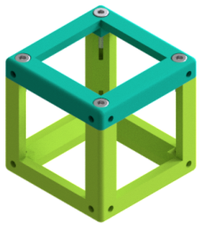
0
1
2
3
4
5
10
15
Imaging with lenses
Use a lens cube to look at the text in a block with a matching focal length. Observe the text through the lens and change the distance between the cube and this page until the focal length description in a block has the same size and orientation as the text UC2 on the left side.
UC2
f = +100 mm
f = +40 mm
f = -50 mm
Can you see the text inside the blocks in the same size and orientation as the one on the left? What is happening when you‘re changing the distance between the lens and the picture?
What happens when you look through a lens on a non-matching text?
YOU.
SEE.
TOO.

Slide 11
Imaging an object with a convex lens
Parallel ray
Focal plane
Lens
Focal plane
Central ray
Image
Optical axis
Object
Focal ray
We take the convex lens as an example, but in principle in works exactly the same for the concave one. We start with an object (the green arrow on the left) and trace the rays coming from its tip. There is an infinite amount of possible rays, but for the imaging we use the following three
The Central ray (orange) that pass the lens without being
The Focal ray (yellow) that starts at the top of the object and passes through the focal point on the object side. After the lens it runs parallel to the optical axis.
The Parallel ray (red) runs parallel to the optical axis at first. The lens will break refract it so that it passes through the focal point on the image side.
The image is formed where all the rays intersect. In this way you can image every point of every object on the object side.
The properties of the image depend strongly on the position of the object with respect to the lens.
YOU.
SEE.
TOO.

Slide 12
Imaging an object with a concave lens
For the concave lens it is now simple. We use the same imaging recipe. The image is always smaller than the object and virtual, no matter where the object is. The magnification depends on the object‘s position. The virtual image is on the object side and can be observed by the eye.
2×f
f
f
2×f
Object side
Image side
The way in which a lens images an object is predictable when the focal length of the lens is known. Therefore you only see the text in the right size for a certain distance between the lens and the page
The magnification and the position of the image depend on the focal length of the lens and the distance between the object and the lens.
With the concave lens (here -50 mm) you always see a smaller virtual image. Virtual image means that it can be seen by the eye. We observed only virtuál images so far.
YOU.
SEE.
TOO.

Slide 13
0
1
2
3
4
5
10
15
Convex lens as a magnifying glass
Take the lens cube with a focal length of 40 mm and use it as a magnifying glass.
The magnifying glass, …
… is a convex lens with a short focal length.
Adjust the lens insert in the cube so that the cube lies on the page and you can read the text by shifting the cube over it.
The magnifying glass is the simplest optical device!
Can you read the tiny letters with the magnifying glass? What is writen there?
YOU.
SEE.
TOO.

Slide 14
What can a convex lens do?
With a convex lens depend the image properties strongly on the position of the object.
Object side
Image side
When the object distance g is more than twice the focal length, then the image is…
inverted
smaller
real
When the object distance g is exactly twice the focal length , then the image is…
inverted
Same size
real
When the object distance g is more than the focal length but less than twice the focal length, then the image is…
inverted
larger
real
2×f
f
g
f
b
2×f
Object distance (g)
The distance between the object and the lens
Image distance (b)
The distance between the image and the
Convex lenses can produce a real image that can be seen on a screen.
YOU.
SEE.
TOO.

Slide 15
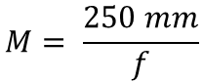
How does the magnifying glass work?
The effect of a magnifying glass!
When the object distance g is less than the focal length, then the image is…
upright
larger
virtual
2×f
f
f
2×f
Object side
Image side
The magnifying glass is the simplest optical device, built with a single convex lens with the right focal length. So how does the 40 mm lens magnify the tiny letters? When the object is in front of the focal point (closer than 40 mm to the lens), the lens creates an virtual image that is magnified and lies behind the object. The eye observes the magnified image through the lens.
Calculate the magnification of the magnifying glass
Magnification
$$M= \frac{250 mm}{f}$$
250 mm is so called conventional near-point distance. It is given by accommodation properties of the eye.
YOU.
SEE.
TOO.

Slide 16
0
1
2
3
4
5
10
15
How does a projector work?
Place the lens cube with the 40 mm lens next to the sample holder cube. The distance between the object and the lens, the object distance g, should be around 50 mm. When you illuminate the object with a flashlight, you can see a sharp image at the distance of roughly 200 mm on a screen (a wall, piece of paper).
f
Convex lens
(40 mm)
2×f
g
Illumination
Object
Use the flashlight of your Smartphone as a light source and hold it behind the object.
Use the picture of the text on the microscope slide in your BOX as the object.
What is the orientation of the image? Slide the lens in its cube and observe when is the image sharp. Find the image for g = 50 mm, 60 mm, 65 mm and measure the image distance.
YOU.
SEE.
TOO.

Slide 17
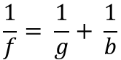
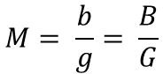
How does a projector work?
Focal length
2×f
f
f
2×f
Object size G
Image size B
Object distance g
Image distance b
Where is the image?
When imaging an object with a convex lens, the position and size of the image depend on the object distance g des and the focal length f.
The Lens equation describes the relationship between the image distance (b) and the object distance (g):
$$\frac{1}{f}= \frac{1}{g}+ \frac{1}{b}$$
What is the image size?
The magnification of the object imaged on the screen is calculated from the following equation:
$$M= \frac{b}{g}= \frac{B}{G}$$
YOU.
SEE.
TOO.

Slide 18
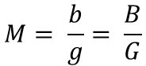
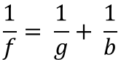
How does a projector work?
Check whether your observation matches the calculation
With the f = 40 mm lens
For g = 50 mm → b = 200 mm
For g = 60 mm → b = 120 mm
For g = 65 mm → b = 104 mm
$$\frac{1}{f}= \frac{1}{g}+ \frac{1}{b}$$
Calculate the magnification for the different g and b.
$$M= \frac{b}{g}= \frac{B}{G}$$
Focal length
2×f
f
f
2×f
Object size G
Image size B
Object distance g
Image distance b
The projector shows always a magnified inverted image. Its position and magnification depend on the object properties. The old-style cinema projector magnifies a film using a strong light source using this principle.
YOU.
SEE.
TOO.

Slide 19
0
1
2
3
4
5
10
15
What is a Galilean telescope?
Place the lenses as shown in the scheme here and look through the telescope on a far away object.
Objective
Eyepiece
Convex lens
100 mm
Concave lens
-50 mm
f_{Objective} - f_{Eyepiece}
What does the image look like? What about its orientation?
While looking through the telescope, adjust the distance between the components in order to see a sharp image!
YOU.
SEE.
TOO.

Slide 20


How does the Galilean telescope work?
A telescope is an optical instrument that magnifies objects, which are far away.
Convex lens
Concave lens
F‘
F‘
Parallel rays
Parallel rays
Long focal length
Short foal length
Objective
Eyepiece
F‘
The lens on the object side is called objective.
The lens in front of the eye is called eyepiece.
f_{Objektiv}
f_{Okular}
This type of telescopes is used in theater binoculars.
YOU.
SEE.
TOO.

Slide 21

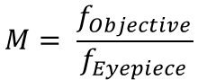
How does the Galilean telescope work?
What is the magnification of this telescope?
Magnification
$$M= \frac{f_{Objective}}{f_{Eyepiece}}$$
Objective
Eyepiece
F‘
f_{Objective}
f_{Eyepiece}
The image is always
Magnified according to the equation above
Upright
The field of view is small
With this type of telescope you cannot reach an extraordinarily high magnification but they are very compact.
YOU.
SEE.
TOO.

Slide 22
0
1
2
3
4
5
10
15
What is a Keplerian telescope?
Place the lenses as shown in the scheme here and look through the telescope on a far away object.
Objective
Eyepiece
Convex lens
100 mm
Convex lens
40 mm
f_{Objective} + f_{Eyepiece}
(empty)
(empty)
What does the image look like? What about its orientation?
While looking through the telescope, adjust the distance between the components in order to see a sharp image!
YOU.
SEE.
TOO.

Slide 23

How does the Keplerian telescope work?
Convex lens
Convex lens
F‘
F‘
Parallel rays
Parallel rays
Long focal length
Short foal length
Objective
Eyepiece
F‘
f_{Objective}
f_{Eyepiece}
This type of telescopes is used in astronomy.
YOU.
SEE.
TOO.

Slide 24
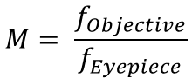
How does the Keplerian telescope work?
Magnification
What is the magnification of this telescope?
$$M= \frac{f_{Objective}}{f_{Eyepiece}}$$
Objective
Eyepiece
F‘
f_{Objective}
f_{Eyepiece}
This type of telescopes can reach a higher magnification than the Galilean one, but it produces an inverted image. This does not matter when observing stars.
The image is always
Magnified according to the equation above
Inverted
The field of view is bigger than in the Galilean telescope.
YOU.
SEE.
TOO.

Slide 25
0
1
2
3
4
5
10
15
What is a terrestrial telescope?
The terrestrial telescope is long, therefore the scheme size does not match.
Place the lenses as shown in the scheme here and look through the telescope on a far away object.
Objective
Inverting lens
Eyepiece
Convex lens
100 mm
Convex lens
40 mm
Convex lens
40 mm
(empty)
(empty)
(empty)
(empty)
f_{Objective} + 2×f_{Inverting lens}
2×f_{Inverting lens} + f_{Eyepiece}
What does the image look like compared to the Keplerian telescope?
While looking through the telescope, adjust the distance between the components in order to see a sharp image!
YOU.
SEE.
TOO.

Slide 26


How does the terrestrial telescope work?
This is the simplest terrestrial telescope. The image is inverted as compared to the Keplerian telescope, which is better for observing objects on the Earth‘s surface. It is in fact a Keplerian telescope with an additional lens that inverts the image.
Keplerian telescope
Objective
Eyepiece
Convex lens
F‘
2×f
f
f
2×f
f_{Objective}
f_{Eyepiece}
Objective
Inverting lens
Eyepiece
f_{Objective}
2×f_{Inverting lens}
2×f_{Inverting lens}
f_{Eyepiece}
YOU.
SEE.
TOO.

Slide 27
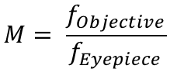
How does the terrestrial telescope work?
Magnification
The magnification is the same as for the Keplerian telescope.
$$M= \frac{f_{Objective}}{f_{Eyepiece}}$$
The inverting lens has only the inverting effect and does not influence the image in other ways.
Objective
Inverting lens
Eyepiece
f_{Objective}
2×f_{Inverting lense}
2×f_{Inverting lens}
f_{Eyepiece}
For terrestrial observations is an upright image necessary. Common terrestrial telescopes use prisms for inverting the image to stay compact.
The image is
Magnified with the same magnification as the one of the Keplerian telescope
Upright
YOU.
SEE.
TOO.

Slide 28
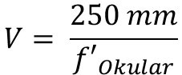

0
1
2
3
4
5
10
15
Light microscope with „Infinity optics“
What happened when you turn around the Keplerian telescope?
As shown in the scheme, place the sample 40 mm in front of the objective and find its image 100 mm behind the tube lens. Use a piece of paper of the box as a screen. Adjust the positions of the components to see a sharp image.
Keplerian telescope!
Objective
Tube lens
Image
Convex lens
40 mm
Convex lens
100 mm
f_{Objektiv}
f_{Tube lens}
Object
(empty)
Illumination
f_{Objective} + f_{Tube lens}
Hold the sample and the objective together. Place the tube lens 100 mm in front of the screen. Change the distance between the objective and the tube lens. How does it influence the image?
YOU.
SEE.
TOO.

Slide 29

What is „Infinity optics“?
A microscope is an optical instrument that makes it possible to see magnified images of objects that are too small to be seen by the naked eye.
Objective
Tube lens
Object
Image
The image is called intermediate image, because it will be further magnified by an eyepiece.
f_{Objective}
f_{Tube lens}
The sample lies in the focal plane of the objective. Therefore all the rays coming from a point within it are parallel after passing through the lens. The objective has a short focal length.
The tube lens forms a real image of the sample by focusing the parallel rays coming from the objective into its focal plane. The tube lens has a longer focal length than the objective.
The image in the intermediate image plane is inverted, magnified and real. The real image can be seen on a screen.
YOU.
SEE.
TOO.

Slide 30
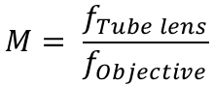
What is „Infinity optics“?
Magnification of the image
What is the magnification of the intermediate image?
$$M= \frac{f_{Tube lens}}{f_{Objective}}$$
Objective
Tube lens
Objective
Tube lens
Object
Intermediate image
Object
Intermediate image
f_{Objective}
f_{Tube lens}
f_{Objective}
f_{Tube lens}
The lenses of the Keplerian telescope can be also used as a microscope when used in different order.
As long as the sample lies in the focal plane of the objective and the screen in the foal plane of the tube lens, the distance between the lenses does not matter, because the rays are parallel.
YOU.
SEE.
TOO.

Slide 31
0
1
2
3
4
5
10
15
„Infinity“ microscope with an eyepiece
Here we build a complete microscope, as shown in the scheme. Place the cubes in their positions. The intermediate image is reflected by the mirror and observed through the eyepiece. What do you see there?
Eyepiece
Build the microscope in layers and look into the eyepiece from above
While looking through the microscope, adjust the positions of the inserts, to see a sharp image of the object.
Convex lens
40 mm
Illumination
Objective
Tube lens
Intermediate image
Convex lens
40 mm
Convex lens
100 mm
Mirror
Object
(empty)
Do you see the microscope image with your eye when using the eyepiece? What is the effect of the mirror? Try to build the microscope without the mirror, making sure there are two empty positions between the tube lens and the eyepiece. How did the image change?
YOU.
SEE.
TOO.

Slide 32
What is the eyepiece for?
Newer microscopes use so-called „infinity“ optics. In this case, the objective doesn‘t form any real intermediate image. The light rays are parallel after passing through the objective. At the end of the tube, which can be arbitrarily long, is a tube lens that forms the intermediate image, which is then again
further magnified by the eyepiece.
Objective
Tube lens
Eyepiece
Object
Intermediate image
f_{Objective}
f_{Objective}
f_{Tube lens}
f_{Tube lens}
f_{Eyepiece}
„Infinite“ tube length that can be arbitrarily long
The image after the eyepiece is inverted, magnified and virtual. The virtual image can be seen by the eye.
This configuration is very useful, because other components, like filters, can be added between the objective and the tube lens without affecting the optical path.
YOU.
SEE.
TOO.

Slide 33
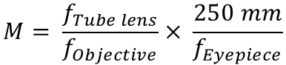
What is the eyepiece for?
Total magnification
What is the magnification after the eyepiece?
$$M= \frac{f_{Tube lens}}{f_{Objective}}× \frac{250 mm}{f_{Eyepiece}}$$
Objective
Tube lens
Eyepiece
Object
Intermediate image
f_{Objective}
f_{Objective}
f_{Tube lens}
f_{Tube lens}
f_{Eyepiece}
An eyepiece is simply a lens that magnifies the intermediate image. It creates a virtual image that can be observed by the eye.
A
A
Mirrors are good not only for looking at your reflection but also for reflecting incoming light and chnaging the direction of the rays. This way you can bend the optical axis to have a more compact microscope. It has no effect on the magnification, but it inverts the image along one axis.
YOU.
SEE.
TOO.

Slide 34
0
1
2
3
4
5
10
15
Light microscope with „finite optics“
Place the cube as shown in the scheme and look into the eyepiece
Build the microscope in layers and look into the eyepiece from above
Eyepiece
Convex lens
40 mm
Illumination
Intermediate image
4×
Objective
Object
(empty)
(empty)
Mirror
Do you see the image just as in the previous experiment? Can you find the intermediate image with a piece of paper?
You can focus the microscope by rotating the little wheel of the objective cube. For moving over longer range, shift the objective in the rail in its insert.
YOU.
SEE.
TOO.

Slide 35
„Finite-corrected“ versus „Infinity“ optics
Objective
Eyepiece
Object
Intermediate image
f_{Objective}
Tube length, as defined by the objective
f_{Eyepiece}
The objectives of older or smaller microscopes are so-called finite-corrected objectives. They behave as a lens with a very short focal length and create an image in a given distance. This distance is called the tube length and it is written on the objective. Our objective has tube length of 160 mm. There we can find a real image, which is further magnified by the eyepiece.
Microscopes allow for focusing the object either by moving the sample or the objective. Here we move the objective using a simple mechanism. Rotation of the wheel moves the objective up and down. Additionally, the objective can be moved over a large distance by shifting in the insert
4×
YOU.
SEE.
TOO.

Slide 36
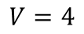
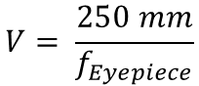
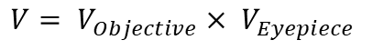
„Finite-corrected“ versus „Infinity“ optics
What is the magnification of the intermediate image?
And what is the magnification after the eyepiece?
Objective magnification
Eyepiece magnification
Total magnification
$$V=4$$
$$V= \frac{250 mm}{f_{Eyepiece}}$$
$V= V_{Objective}× V_{Eyepiece}$
as written on it
Objective
The image is bigger than with the infinity microscope. The magnification of our objective is 4× and if you calculated the magnification in the previous experiment, this does not surprise you.
Object
Tube lens
Intermediate image
Eyepiece
f_{Objective}
f_{Tube lens}
f_{Eyepiece}
Objective
Intermediate image
Eyepiece
Object
f_{Objective}
f_{Eyepiece}
The intermediate image is now created by the objective only and lies 160 mm behind it, roughly on the mirror‘s surface.
Tube length, as defined by the objective
YOU.
SEE.
TOO.

Slide 37
0
1
2
3
4
5
10
15
Objective and Eyepiece
Look carefully on our objective. What is inside and what is written on it?
Open the cubes with the 40 mm lenses. Place both insert in one cube, as far from each other as possible, with the convex sides of the lenses facing each other.
2× Convex lens
40 mm
4/0.10
160/0.17
The objective is a convex lens with a short focal length.
Look at the square grid through a single 40 mm lens and through the cube you‘ve just built.
Use the 40 mm lens and the objective as a magnifying glass and read the tiny letters.
Which of the lenses has a bigger magnification and what is written there?
How does the magnification and the field of view changes?
YOU.
SEE.
TOO.

Slide 38
What is an objective?
An objective is an optical system that produces a magnified image of an object. The numbers written on it describe its features.
Magnification:
Common magnifications are 4×, 10×, 40×, 100×
Numerical Aperture :
This describes the resolution.
Tube length :
∞ means infinity, 160 means 160 mm and it is the most common finite tube length
4/0.10
160/0.17
Cover slip correction :
Often the sample is kept on a microscope slide under a cover glass. The objective hs to be corrected for its thickness (0,17 mm)
The 4× Objective has only a single lens inside. Objective with higher magnification are whole lens systems.
The objective is also a convex lens with a short focal length. The 4× objective has a focal length of f=32 mm. When used as a magnifying glass, it has therefore higher magnification as the 40 mm lens. The field of view is small but without distortion.
YOU.
SEE.
TOO.

Slide 39
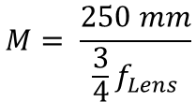
What is an eyepiece?
An eyepiece is like a magnifying glass that magnifies the intermediate image. The eyepiece we built here is called the Ramsden eyepiece. A single lens can be also used. With a lens system, like the Ramsden eyepiece, is the field of view less distorted. This eyepiece is composed of two lenses with the same focal length and its total focal length is f_{Ramsden eyepiece} = 3/4 f_{Lens}
$$M= \frac{250 mm}{{\frac{3}{4}f}_{Lens}}$$
What is the magnification of the Ramsden eyepiece?
Intermediate image
d = 2/3 f_{Lens}
Every eyepiece has a so-called Ramsden disc. It s the smallest diameter of the light rays bundle coming out of the eyepiece.
The field of view is bigger and it seems clearer with the Ramsden eyepiece.
YOU.
SEE.
TOO.

Slide 40

0
1
2
3
4
5
10
15
Smartphone microscope
Illumination
Build the Smartphone microscope as shown in the scheme. Place two random cubes under the Smartphone holder for its stability.
Object
or
Smartphone camera
4×
Build the microscope in layers and look into the eyepiece from above
Objective
Ramsden- Eyepiece
Exchange the Ramsden eyepiece for the single 40 mm lens again. Which one is better for the eye and which one is better for the Smartphone?
Mirror
(empty)
Mirror
YOU.
SEE.
TOO.

Slide 41
Better for the Smartphone or the eye?
The Smartphone camera has a lens with a very short focal length, in order to fit the camera system into the thin flat phone. The lens creates an image on the camera chip in a similar way like the eye creates an image on its retina.
The eye can image object from far and close distances. This ability is called accommodation.
The Smartphone camera can do that too, but using an autofocus mechanism. This enables focusing object from a large distance range onto the camera chip
Accommodation
Autofocus
The image comes from the eyepiece in parallel light rays, like if it was coming from the infinity. It can be seen by the relaxed (non-accommodated) eye or the camera focused on infinity.
YOU.
SEE.
TOO.

Slide 42
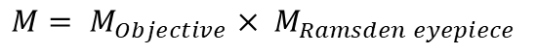
Better for the Smartphone or the eye?
Magnification
What is the magnification of the Smartphone microscope?
$M= M_{Objective}× M_{Ramsden eyepiece}$
In order to see the microscope image the pupil, which defines how much light gets through, must match the Ramsden disc. The pupil of the eye is in the iris, inside the eye and cannot be brought too close to the eyepiece. On the other hand, the Smartphone is think and the camera pupil is almost on its surface. Because of this difference, the distance from the eyepiece is different for the eye and the camera.
Pupil of the eye
In the case of the Ramsden eyepiece is the Ramsden disc very close to the cube. This works for the Smartphone camera but not so well for the eye.
The Ramsden disc of the 40 mm lens is bigger and therefore the observation of the sample is more comfortable.
YOU.
SEE.
TOO.
Pupil of the camera

Slide 43
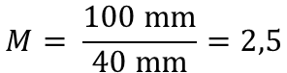
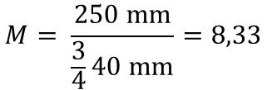
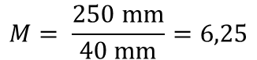
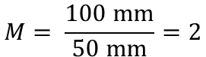
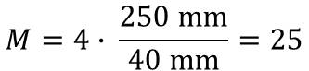
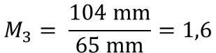
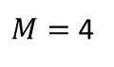
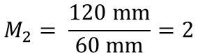
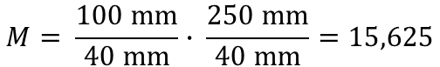
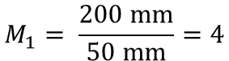
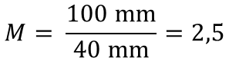
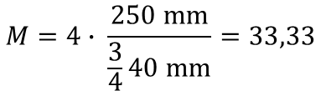
Calculation results
Magnifying glass
„Infinity“ microscope
$$M= \frac{\text{250 }\text{mm}}{\text{40 }\text{mm}}=6,25$$
$$M= \frac{\text{100 }\text{mm}}{\text{40 }\text{mm}}=2,5$$
Projector
„Infinity“ microscope with eyepiece
$$M_{1}= \frac{\text{200 }\text{mm}}{\text{50 }\text{mm}}=4$$
$$M= \frac{\text{100 }\text{mm}}{\text{40 }\text{mm}}∙ \frac{\text{250 }\text{mm}}{\text{40 }\text{mm}}=15,625$$
„Finite“ microscope – Intermediate image
$$M_{2}= \frac{\text{120 }\text{mm}}{\text{60 }\text{mm}}=2$$
$M=$4
$$M_{3}= \frac{\text{104 }\text{mm}}{\text{65 }\text{mm}}=1,6$$
„Finite“ microscope – Total magnification
$$M=4∙ \frac{\text{250 }\text{mm}}{\text{40 }\text{mm}}=25$$
Galilean telescope
$$M= \frac{\text{100 }\text{mm}}{\text{50 }\text{mm}}=2$$
Ramsden eyepiece
$$M= \frac{\text{250 }\text{mm}}{\frac{\text{3}}{\text{4}}\text{40 }\text{mm}}=8,33$$
Keplerian telescope
$$M= \frac{\text{100 }\text{mm}}{\text{40 }\text{mm}}=2,5$$
Smartphone microscope with Ramsden eyepiece
$$M=4∙ \frac{\text{250 }\text{mm}}{\frac{3}{4}\text{40 }\text{mm}}=33,33$$
YOU.
SEE.
TOO.

Slide 44
Probenhalter
Spiegel
Spiegel
Sammellinse
40 mm
Sammellinse
40 mm
Sammellinse
100 mm
Zerstreuungslinse
-50 mm
4×
Pack mich ♥
Objektiv
YOU.
SEE.
TOO.

